Slide 1
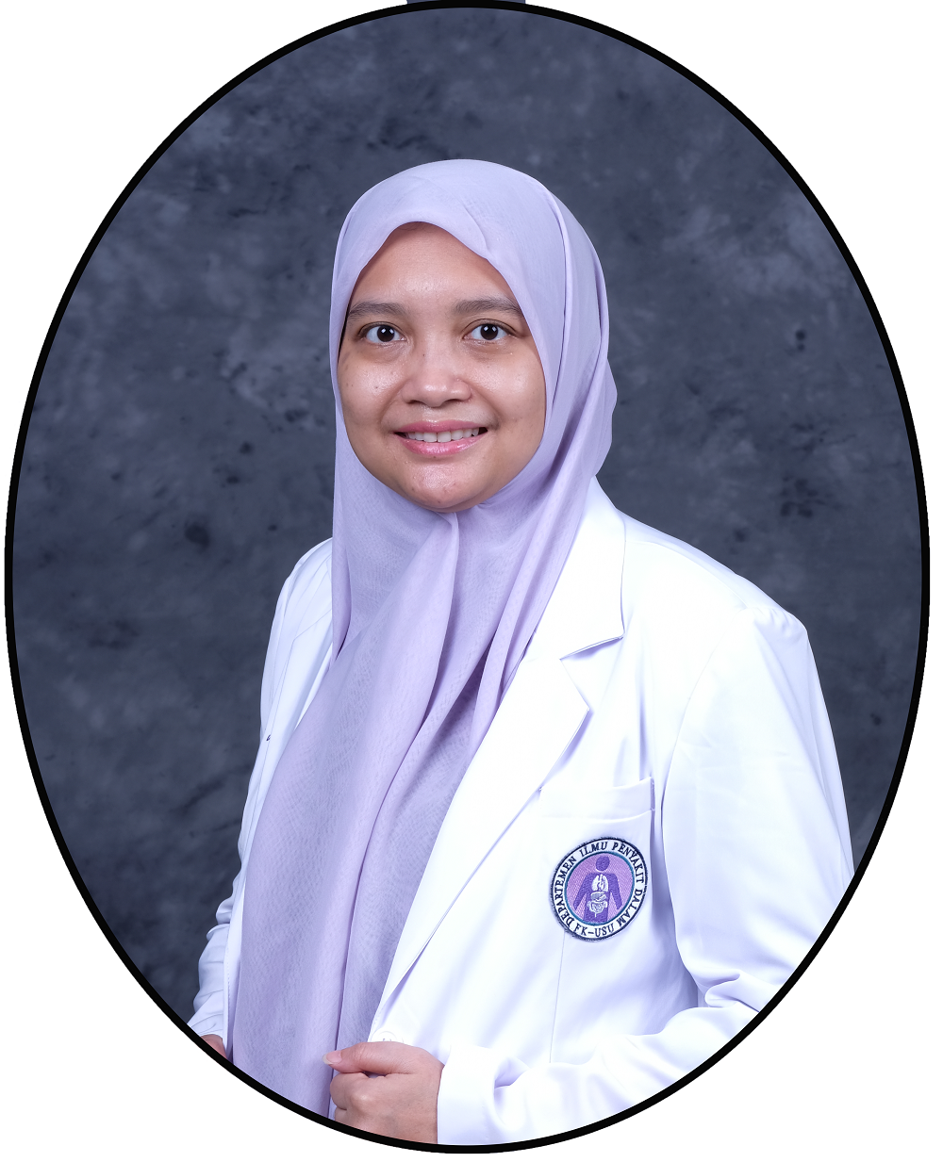
dr. Dina Aprillia Ariestine, M.Ked(PD), Sp.PD, K.Ger
Nama : dr. Dina Aprillia Ariestine, M.Ked(PD), Sp.PD, K.Ger
Jenis kelamin : Perempuan
Tempat dan tgl. lahir : Medan, 11 April 1981
E-mail : dina.aprillia@usu.ac.id
Riwayat Pendidikan
Fakultas Kedokteran USU : 2005
Spesialis Ilmu Penyakit Dalam FK USU : 2012
Subspesialis Geriatri FK UI : 2020
Clinical Observership Training The University of Tokyo Hospital, Japan : 2023
Clinical Observership Program Far Eastern Memorial Hospital, Taiwan : 2024
Riwayat Pekerjaan
Ketua Departemen Ilmu Penyakit Dalam FK USU : 2021 – Sekarang
Dokter Spesialis Penyakit Dalam Konsultan Geriatri RSUP H. Adam Malik Medan
Dokter Spesialis Penyakit Dalam Konsultan Geriatri RS Prof CPL USU
Dokter Spesialis Penyakit Dalam Konsultan Geriatri RS Regina Maris
Tim Geriatri RSUP H. Adam Malik Medan
Keanggotaan Profesi
Anggota Ikatan Dokter Indonesia (IDI)
Anggota Perhimpunan Ahli Penyakit Dalam Indonesia (PAPDI)
Ketua Perhimpunan Gerontologi Medik Indonesia (PERGEMI) Sumatera Utara

Slide 2
PROSES MENUA:
PERUBAHAN YANG TERJADI
PADA USIA LANJUT
dr. Dina Aprillia Ariestine, M.Ked(PD), Sp.PD-KGer
Divisi Geriatri
Departemen Ilmu Penyakit Dalam
FK USU/RSHAM

Slide 3
Demography and Epidemiology
Introductions
Populations have aged at different speeds and during different time periods throughout the world.
Over the past century there have been truly remarkable changes in the numbers and characteristics of older persons throughout the world. The growth of the older population has resulted from a general increase in the overall population size but has been particularly affected by major declines in several of the leading causes of mortality. The increased survival of older persons has also been accompanied by declining birth rates
The proportion of the population aged 65 and older has increased dramatically and will continue to increase for the next 50 years. These demographic transformations have an effect on society that reverberates well beyond the increased medical care needs associated with an older population.

Slide 4
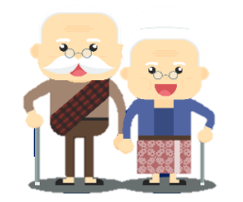
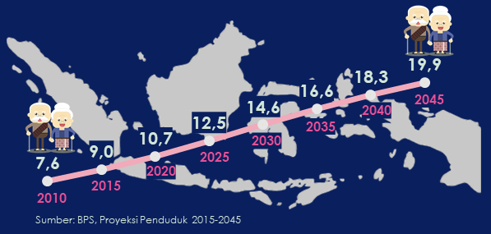
Indonesia
9,92% (26,82 million)
lansia di Indonesia

Slide 5
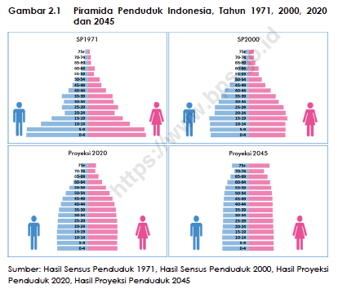

Slide 6
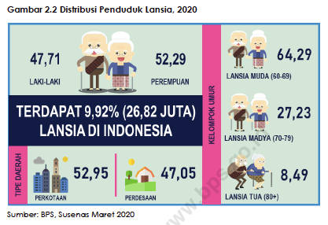
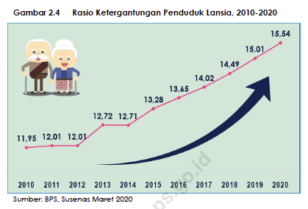

Slide 7
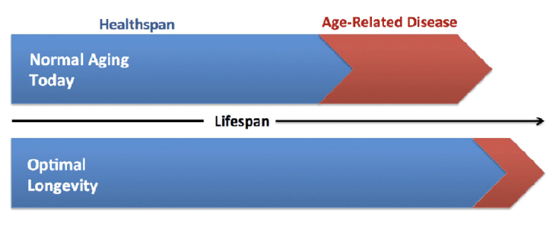

Slide 8
Increased longevity can potentially enable older adults to remain engaged for longer,
resulting in positive outcomes for the individual, their families, and society as a whole.
However increasing longevity is not always associated with extended periods of good health. For those living with functional decline and disability, there is an increased demand on health and social care, and limitations on contributions they can make to society
CONSEQUENCE
Increased prevalence of geriatric syndromes, related to frailty, cognitive impairment, incontinence, delirium, and falls, compromise independence and increase demand for health and aged care services

Slide 9
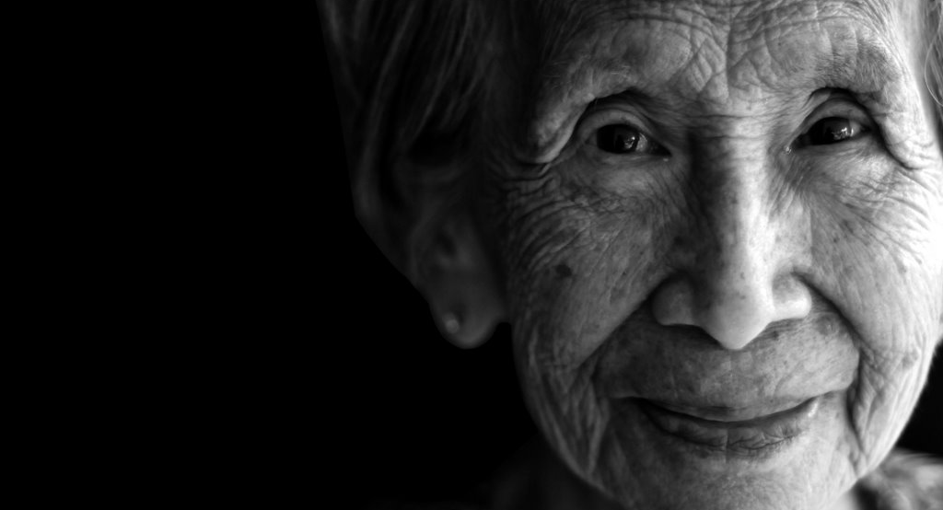
What
Is Aging?
Aging is the process that converts young adults, most of them healthy and in no need of assistance from physicians, into older adults whose deteriorating physiologic fitness leads to progressively increasing risks of illness and death.
Aging can be characterized as a multisystem decline in healthy performance with time. As the aging process begins after maturation, deteriorative, regenerative, and compensatory changes develop over time and result in diminished physiologic reserve capacity and an increased vulnerability to challenges, particular disease, and a decrease in the ability to survive.

Slide 10
Multiple mechanisms of aging
delayed by good diet, lifestyle,
and favorable environment
accelerated by stress, poor
diet, adverse environment
age-related frailty, disability, and disease
interfere performance & functional reserves of tissues and organs
accumulation of cellular defects
random molecular damage
Hazzard’s Geriatric Medicine and Gerontology. 6th ed. New York: Mc Graw Hill; 2009.p.3-14.

Slide 11
Theories of aging
Oxidative damage/ free radicals
DNA damage and repair
Telomere shortening
Inflammation
Glycocilation
Neuro-endocrine
etc
“It is highly unlikely that any single mechanism can explain all of aging process”
Hazzard’s Geriatric Medicine and Gerontology. 6th ed. New York: Mc Graw Hill; 2009.p.15-21. Tosato, et al. Clin Inter Aging.2007;2(3):401-12.

Slide 12
Aging and Homeostatic Regulation
Common Features Of Homeostatic Dysregulation In Old Age
HOMEOSTENOSIS
HIGHER BASAL ACTIVITY
DIMINISHED PHYSIOLOGIC RESERVE
EXCESSIVE RESPONSE TO STRESSORS
LOSS OF COMPLEXITY
DIMINISHED END-ORGAN RESPONSIVENESS
ENHANCED VARIABILITY
LOSS OF NEGATIVE FEEDBACK
ALLOSTATIC LOAD

Slide 13
Endocrinology and Metabolism
↓ testosterone, GH, insulin, adrenal androgens, aldosterone, & thyroid hormone
↓ thermoregulation
↓ febrile response
↓ basal metabolic rate
↑ nodularity & fibrosis of thyroid
Insulin resistance
Impaired insulin secretion
Respiratory
↓ Elastic recoil; ↓ lung tissue elasticity
↑ Chest wall stiffness; thoracic wall calcification
↑ V/Q mismatch
Cilia atrophy
↓ respiratory muscle strength
↓ PaO₂
Atrophy of endocardium muscle fibers; Valvular degeneration
Atherosclerosis of vessels;
↑ Vascular stiffness
↑ systolic blood pressure
↑ Ventricular stiffness; ↓ compliance of the LV
↓ number of pacemaker cells; conduction system degeneration
↓ sensitivity of baroreceptors
↓ Maximal heart rate Cardiopulmonary deconditioning
↑ Prevalence of coronary artery disease
Cardiovascular

Slide 14
Gastroenterology
Fibrosis and atrophy of salivary glands ↓ liver size
Atrophy of and ↓ in number of taste buds ↓ hepatic blood flow
Slowing in esophageal emptying ↓ hepatic microsomal oxidation
↓ HCl acid secretion; ↓ gastric acid secretion
Atrophy of the mucosal lining
↓ absorption of Ca
↓ muscle tone in bowel
Neurology
↓ number of neurons & ↑ in size & number of neuroglial celss
Decline in nerves & nerve fibers
Atrophy of the brain & ↑ in cranial dead space
Thickened leptomeninges in spinal cord
Immunology
↓ Immune function
↓ T-cell activity

Slide 15
Mobility and Rheumatology
↓ muscle mass
↓ myosin adenosine triphosphatase activity
Deterioration & drying of
joint cartilage
↓ bone mass & osteoblastic activity
Nephrology
↓ renal mass
Loss of glomeruli; ↓ number of nephrons
Decline in number of functioning nephrons
↓ decreased Na and water excretion
Changes in small vessel walls
↓ bladder muscle tone
Prostatic hypertrophy
Skin/Integumentary
Loss of dermal & epidermal thickness Decline in fibroblast proliferation
Flattening of papillae ↓ Reepithelialization
Atrophy of sweat glands ↓ Dermal blood vessels
↓ vascularity
Collagen cross-linking
Elastin regression
Loss of subcutaneous fat
↓ melanocytes

Slide 16
Organ Systems and Disease
Endocrinology and Metabolism
Respiratory
COPD, Diffuse parenchymal lung disease, aspiration
Thyroid disease, Diabetes melitus, dyslipoproteinemia, hyperparathyroidism.
Cardiovascular
Gastroenterology
Atherosclerosis, Coronary heart disease, heart failure, arrhytmias, hypertensio, postural hypotension.
Hepatic disease, billiary and pancreatic disease, upper GI disorders, common large intestinal disorders, constipation, esophageal spasm, and diverticular disease
Neurology
Skin/Integumentary
Cerebrovascular disease, neurodegenerative disorder, parkinson, dementia
Dryness, pruritus, wrinkle, wounds

Slide 17
Organ Systems and Disease
Mobility and Rheumatology
Nephrology
Osteoarthritis, osteoporosis, Hip fractures, Myophaties, polimyalgia rheumatica, giant cell arteritis, back pain, spinal stenosis, foot problems, fibromyalgia,
Renal disease, end-stage renal disease, fluid and electrolyte imbalance, UTI, incontinence
Oncology
Infectious Disease
Breast disease, prostate cancer, lung cancer, GI malignancies, Intracranial Neoplasm, Skin cancer
Pneumonia, Urinary tract infection, HIV, Herpes zooster, Influenza and RSV

Slide 18
 | Organ / System | Common Age Changes | Clinical Implication
 | Reproductive | Atrophy & fibrosis of cervical & uterine walls | Vaginal dryness & burning & pain with intercourse
 |  | ↓ vaginal elasticity & lubrication | ↓ seminal fluid volume & force of ejaculation
 |  | ↓ hormones & reduced oocytes | ↓ elevation of the testes Prostatic hypertrophy
 |  | ↓ seminiferous tubules Proliferation of stromal & glandular tissue | Connective breast tissue is replaced by adipose tissue
 |  | Involution of mammary gland tissue
¹ Essentials of clinical geriatrics 6th ed. New York: McGraw Hill; 2009.p.3-22.
² Hazzard’s Geriatric Medicine and Gerontology. 6th ed. New York: Mc Graw Hill; 2009.p.3-14.

Slide 19
Organ / System | Common Age Changes | Clinical Implication
Sensory: vision | ↓ rod & cone function Pigment accumulation | ↓ visual acuity, visual fields & light/dark adaptation ↑ sensitivity to glare ↑ incidence of glaucoma Distorted depth perception with ↑ falls Less able to differentiate blues, greens, and violets ↑ eye dryness & irritation
 | ↓ speed of eye movements
 | ↑ intraocular pressure
 | Ciliary muscle atrophy
 | ↑ lens size & yellowing of the lens
 | ↓ tear secretion
¹ Essentials of clinical geriatrics 6th ed. New York: McGraw Hill; 2009.p.3-22.
² Hazzard’s Geriatric Medicine and Gerontology. 6th ed. New York: Mc Graw Hill; 2009.p.3-14.

Slide 20
Some of physiological changes of aging and its clinical implications
Organ /System. Common Age Changes Clinical Implication
Sensor: hearing
Loss of auditory neurons
Loss of hearing from high to low frequency
↑ cerumen Angiosclerosis of ear
↓ hearing acuity & isolation (specifically, ↓ ability to hear consonants)
Difficulty hearing, especially when there is background noise, or when speech is rapid
Cerumen impaction may cause hearing loss
Sensory: smell, taste, and touch
↓ number of olfactory nerve fibers
Altered ability to taste sweet & salty foods; bitter & sour tastes remain
↓ sensation
Inability to smell noxious odors
↓ food intake
Safety risk with regard to recognizing dangers in the environment: hot water, fire alarms, or small objects that result in tripping
¹ Essentials of clinical geriatrics 6th ed. New York: McGraw Hill; 2009.p.3-22.
² Hazzard’s Geriatric Medicine and Gerontology. 6th ed. New York: Mc Graw Hill; 2009.p.3-14.

Slide 21
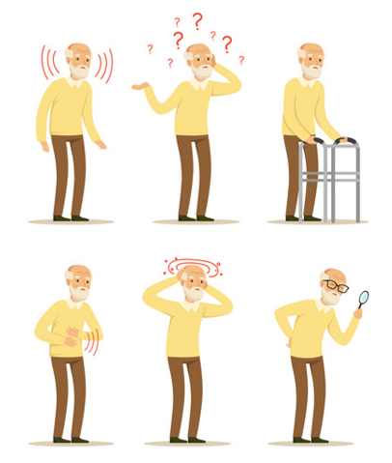
Karakteristik Pasien Geriatri
Mempunyai banyak penyakit penyerta
Penurunan kapasitas fisiologis tubuh
Malnutrisi
Presentasi klinis yang khas
Penurunan status fungsional tubuh

Slide 22
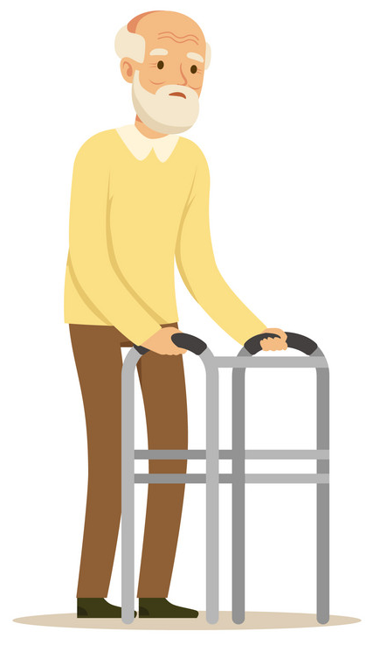
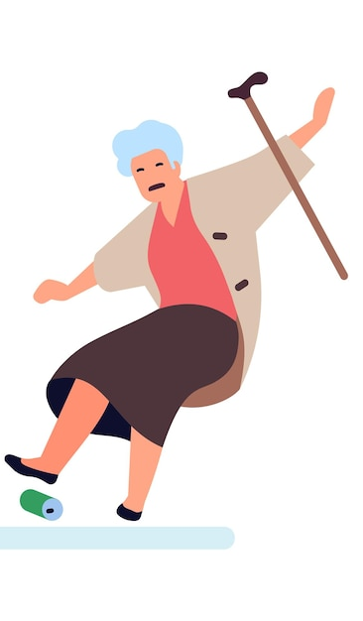
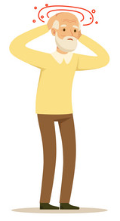
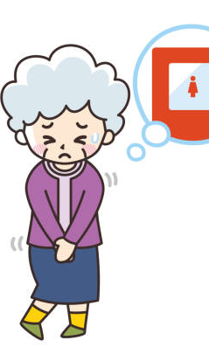

Sindroma Geriatri
Kerapuhan/Frailty
Jatuh
Pusing
Inkontinensia
Delirium

Slide 23
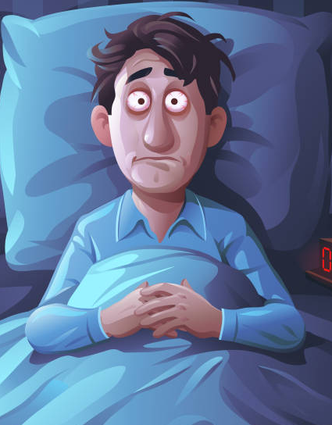
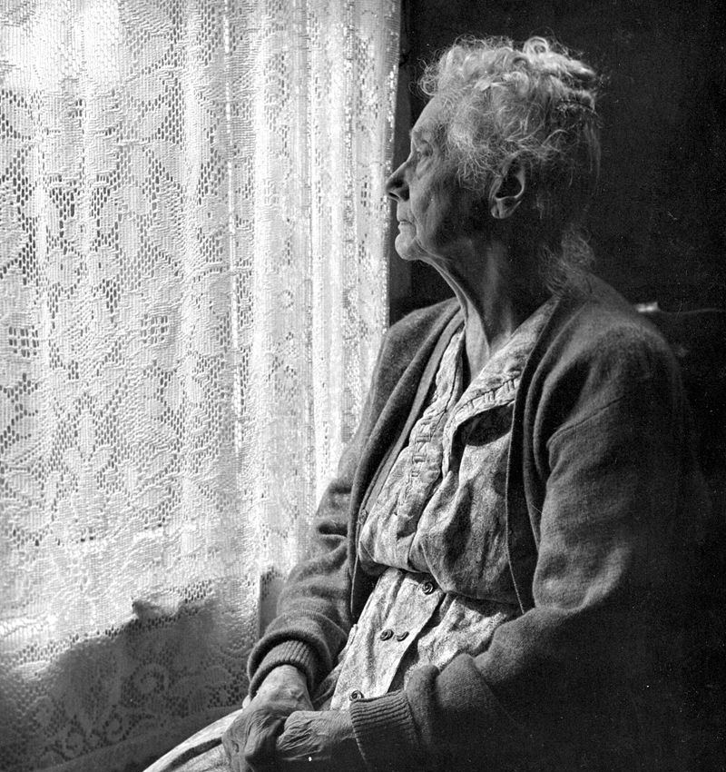
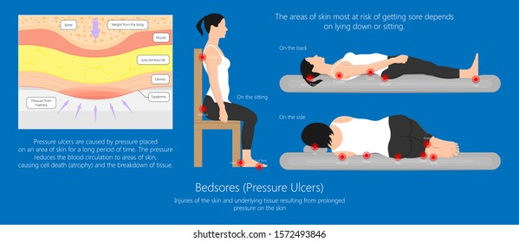
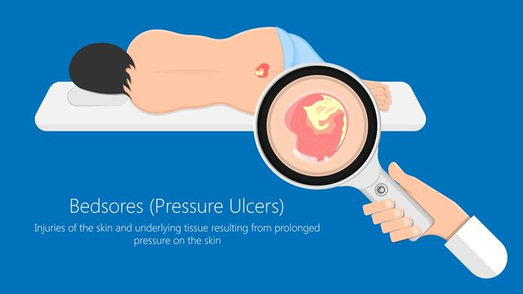
Sindroma Geriatri
Gangguan Tidur
Elder Mistreatment
Pressure Ulcers

Slide 24
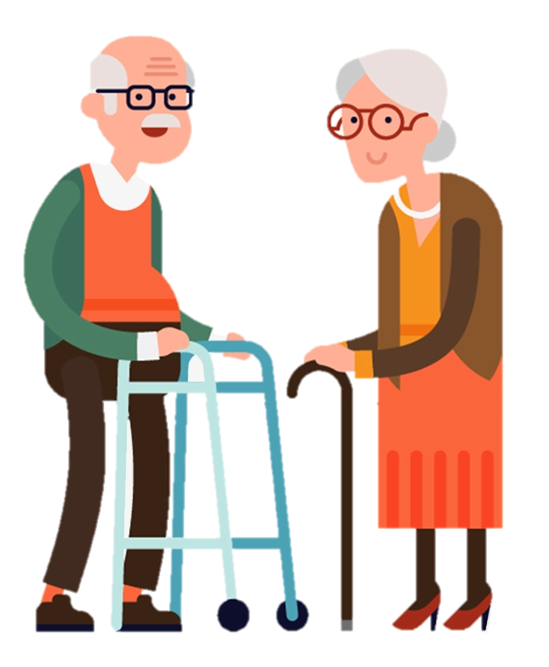
14 I
Infection
Inanition
Impaction
Insomnia
Iatrogenic
Impairment of hearing, vision and smell
Impecunity
Immobility
Instability
Intellectual impairment
Incontinence
Isolation
Impotence
Immunodeficiency

Slide 25
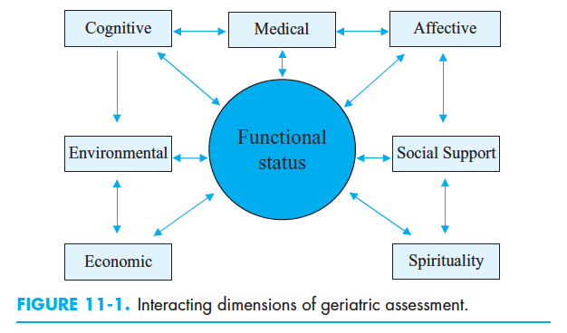
Hazzard’s Geriatric Medicine and Gerontology. 6th ed. New York: Mc Graw Hill; 2009.p.141-52.

Slide 26
Frailty Syndrome
“sindrom biologis terkait usia, berupa penurunan kapasitas fisiologis dan daya tahan terhadap stressor akibat akumulasi penurunan berbagai sistem fisiologik tubuh yang berdampak pada terjadinya luaran kesehatan yang buruk.”
Konsep frailty mencakup ranah :
  Fisis (aktifitas fisis, mobilitas, kekuatan otot dan energi)
  Psikologis (kognitif dan mood)
  Sosial (interaksi/dukungan sosial)
Fried LP, et al. J Gerontol Med Sci. 2001;56(3): M146-56.
Rockwood K, Drugs Aging. 2000;17:295-302.

Slide 27
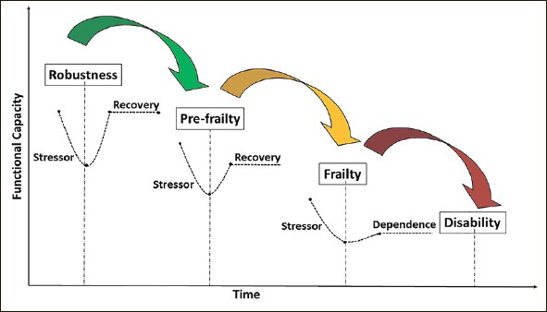

Slide 28
Aging Process | Lifestyles | Diseases | Genetics
Frailty
Age-related
Accumulation of ↓ physiologic reserved capacity
Susceptible to worsening clinical outcome
Geriatric Syndrome
↓ mobility
↓ functional status (disability)
Hospitalization dan institutionalization
Mortality (HR 1,23-1,79)
↓ Health-related QoL
Fried LP, et al. J Gerontol Med Sci 2001;56(3) M146-56.
Rockwood K, et al. Drugs Aging 2000; 17:295-302.
Strandberg TE, et al. European Geriatric Medicine 2011, 2:344-55.
Song al. JAM Geriatr Soc 2010,58:681-7.

Slide 29
ISSUE
Aging Process
Successful Aging | Usual Aging | Pathologic Aging
↑ Risk of frailty
Lowry KA, et al. Aging and Disease 2012,3(1):5-15.
Bourdel-Marchasson I, et al. Metabolic Diabetes. 2005,31:5S13-9.
Hazzard's Geriatric Medicine and Gerontology. 6th ed. New York McGraw Hill 2009.p.631-45.
Strandberg TE, et al. European Geriatric Medicine 2011, 2:344-55.

Slide 30
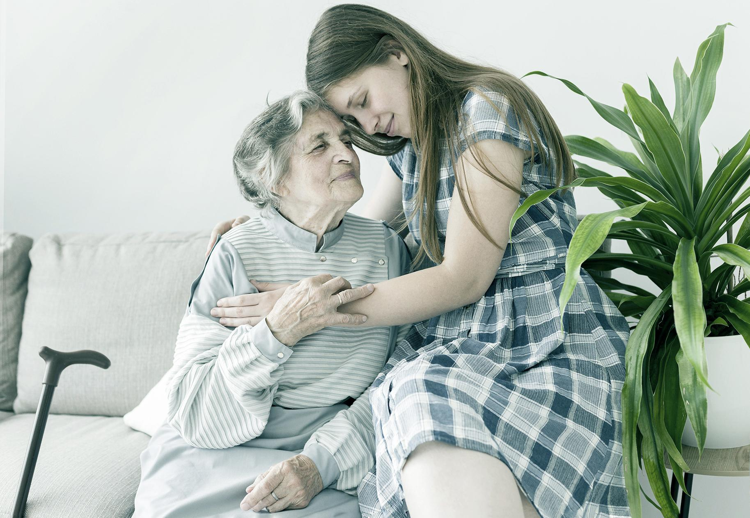

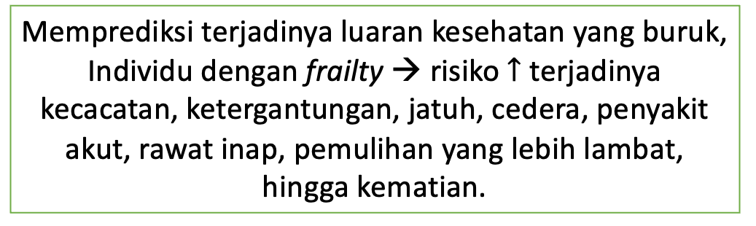
Frailty) → ancaman besar akan harapan populasi usila untuk dapat hidup aktif
Mengalami penurunan signifikan dari kapasitas fisiologik dan daya tahan terhadap stresor
Memprediksi terjadinya luaran kesehatan yang buruk, Individu dengan frailty → risiko $↑$ terjadinya kecacatan, ketergantungan, jatuh, cedera, penyakit akut, rawat inap, pemulihan yang lebih lambat, hingga kematian.
Memiliki toleransi yang lebih buruk terhadap berbagai prosedur medis/ invasif → rentan tejadi komplikasi
Lansia yang FRAIL
Peningkatan biaya perawataan kesehatan (heath-care costs), terlepas dari faktor usia kronologis.

Slide 31
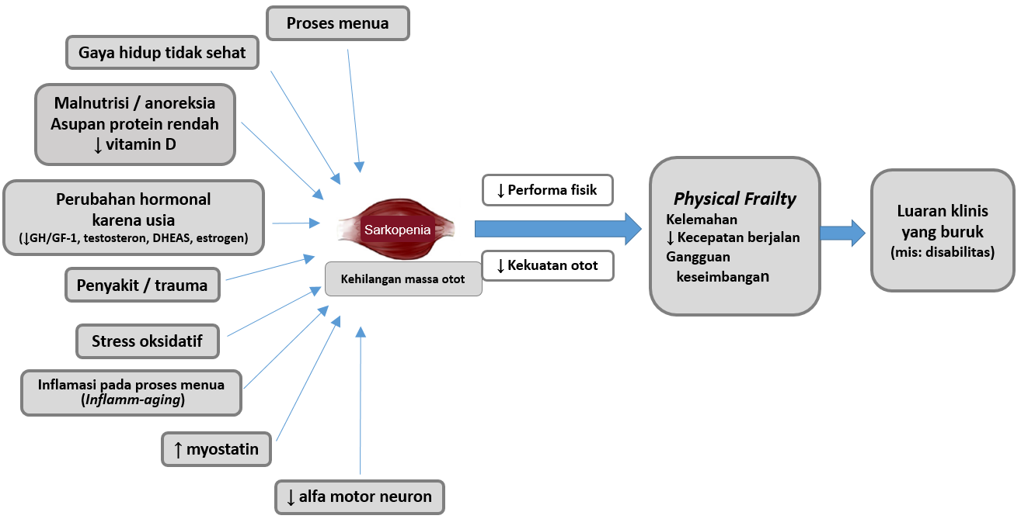
Keterkaitan Sarkopenia dan Frailty
Gambar 2. Sarkopenia Sebagai Elemen Utama Frailty
Landi F, et al. European Geriatric Medicine.2016;7:197-200.

Slide 32
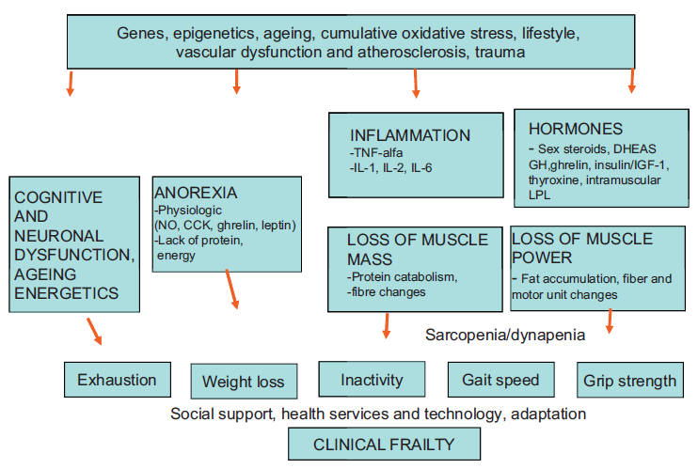
Etiologic and pathogenetic factors contributing to phenotypic frailty
CCK: cholecystokinin, DHEAS: dehydroepiandrosterone sulphate, GH: growth hormone, IGF:insulin-like growth factor, IL: interleukin, LPL: lipoprotein lipase, NO: nitric oxide.

Slide 33
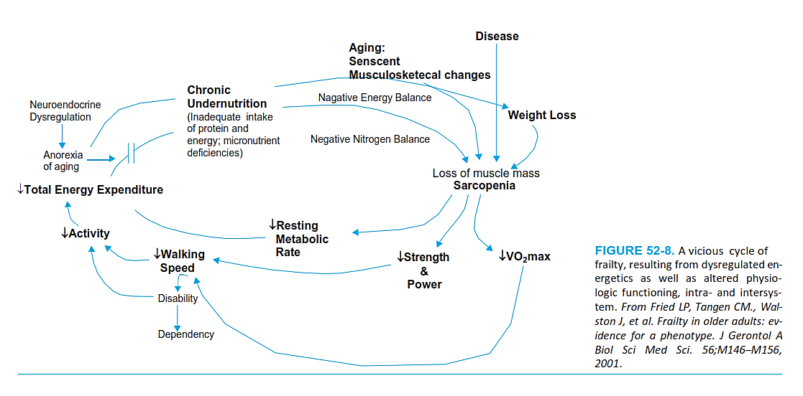

Slide 34
Concepts of Aging Well
The concept of aging well has been given considerable attention in the literature. “Aging well” is often defined synonymously with “successful ageing”, “positive ageing,” “good old age,” “active ageing,” “robust ageing,” “healthy ageing,” “productive ageing,” “vital ageing,” and “optimal ageing,”.
Rowe and Kahn are frequently cited for introducing the concept of “successful ageing,” and their model is one of the most widely used in the scientific literature. Despite its widespread use, the term “successful ageing” has generated criticism.
“Success” is often associated with economic or material
achievement, especially in a Western culture where the ideal of success is reflected in the lifestyles of the fortunate elite.

Slide 35
Rowe & Kahn:
➢Successful aging: show minimal declines in physiologic function
a) Absence or avoidance of disease & risk factors for disease,
b) Retaining a high level of cognitive function,
c) Active engagement in life
➢Aging usually: health & functional status are in accordance with physiological aging; show disease related decrements & loss of reserve capacity, commonly interpreted as the effects of age
➢Pathologic aging: has chronic diseases or disabilities with subsequent functional dependency
Baltes and Baltes:
Successful aging: the ability to optimize adaptation, i.e. making the most of one’s remaining capacities and compensating for losses & limitations

Slide 36
The model of successful aging posited by Rowe and Khan approach has been criticized for being a medically-oriented model which:
Neglects social relationships and engagements
Oblivious to cultural differences
Fails to consider the developmental process throughout the
individual’s lifespan
Overlooks mental wellbeing
01
02
04
04
05
06
07
08
Underestimates the influence of contextual factors
Ignores the interactions between individuals
And their environments
Fails to take into account the disadvantages that accumulate over the life course
Does not
Acknowledge that successful aging is possible for those with
Chronic disease or disabilities
Quigley R, Russell SG, Larkins S, Taylor S, Sagigi B, Strivens E, Redman-MacLaren M. Aging Well for Indigenous Peoples: A Scoping Review. Front Public Health. 2022 Feb 10;10:780898. doi: 10.3389/fpubh.2022.780898. PMID: 35223727; PMCID: PMC8866315.

Slide 37
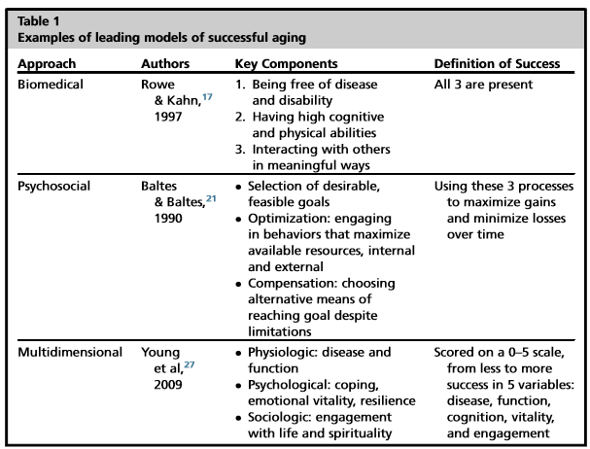
Models of Healthy Aging
Aronson, L., 2020. Healthy Aging Across the Stages of Old Age. Clin Geriatr Med, Volume 36, pp. 549-558.

Slide 38
Pathologic aging Impairment-Disability-Handicap
A disease may create impairment in organ function which can lead to a reduced ability to perform certain tasks (disability). This inability may become a handicap when those tasks are necessary to carry out social activities.

Slide 39
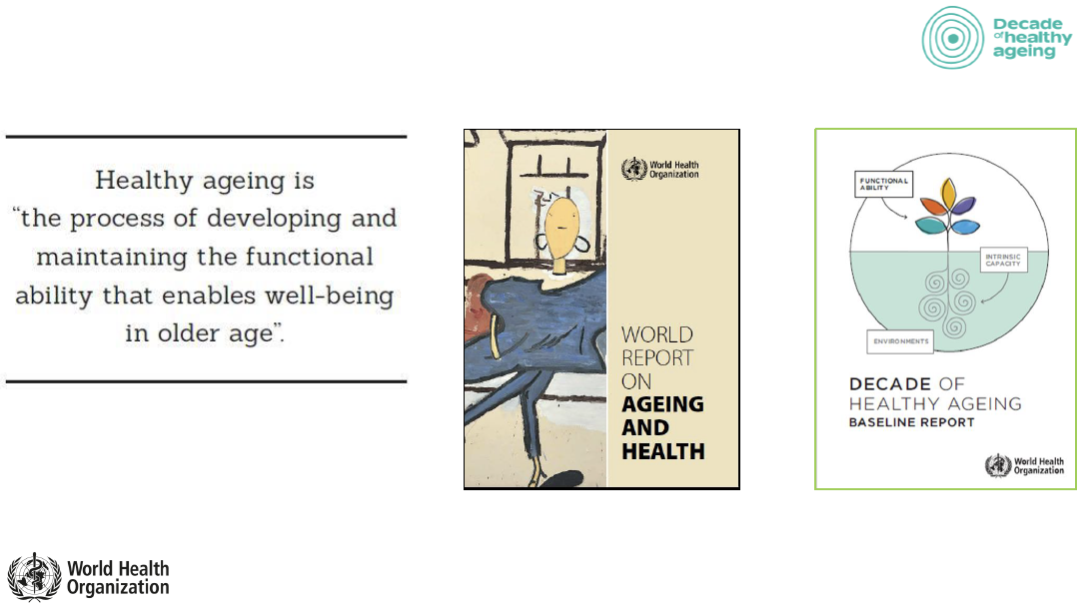

Slide 40

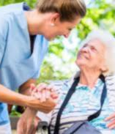
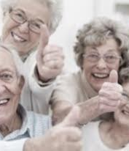
Healthy Aging is a process of developing and maintaining functional abilities or physical, social and mental health that can maintain well-being at an older age, in order to improve the quality of life as people age.
For this reason, the concept of healthy aging must continue to be disseminated, not only for the elderly (senior) group, but also for the adult age group (pre-senior) today so that they can prepare for old age that remains healthy.
Sumber: the Pan American Health Organization (PAHO/WHO)

Slide 41
Healthy Aging
development and maintenance of functional capacity
contribute to the well-being of the elderly
create environments and opportunities that enable older people to do what they value throughout their lives.
World Health Organization. World Report on Ageing and Health. Geneva (2015).

Slide 42
Active vs. healthy aging
Free From Disease Is Not A Requirement For Healthy Aging(Healthy Aging)
Many Elderly Have 1 or More Health Conditions;
Active And Healthy Aging
Reducing pressure on health care and social services.
If Controlled Well → Has little influence on their well-being.
Contributing to family, community, economy, and environment.
Can continually contribute his skills, knowledge, and experience to the community.
A Abyad, From active ageing to health ageing, QJM: An International Journal of Medicine, Volume 111, Issue suppl_1, December 2018, hcy200.067, https://doi.org/10.1093/qjmed/hcy200.067

Slide 43
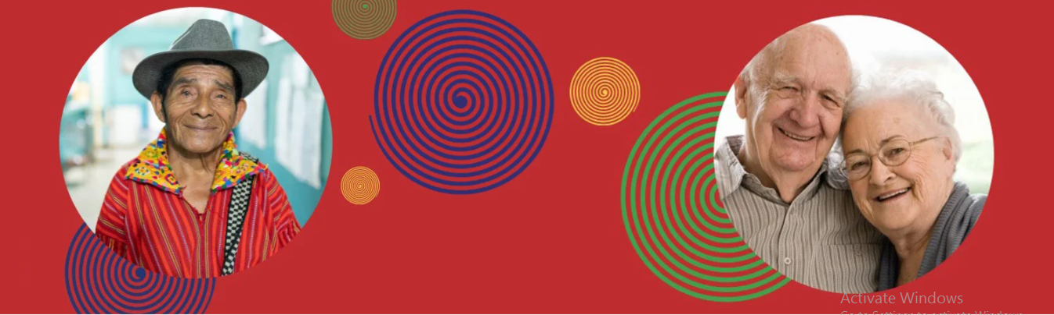
Decade of Healthy Aging
2021–2030

Slide 44
Decade of Healthy Aging 2021–2030
The United Nations General Assembly
Declaring 2021–2030 as the decade of healthy aging
Decade of Healthy Aging → global collaboration
Bringing together government, civil society, international institutions, professionals, academia, media and the private sector for 10 years of concerted, catalytic and collaborative action to promote longer and healthier lives.
Ask WHO to lead implementation.
Support the realization of the UN 2030 agenda on the SDG
World Health Organization. UN Decade of Healthy Ageing 2021-2030. available at: https://www.who.int/initiatives/decade-of-healthy-ageing

Slide 45
Decade of Healthy Aging 2021–2030
Improving the lives of the elderly, their families, and the community the elderly live in.
The COVID-19 pandemic affects the well-being of the elderly
The Decade of Healthy Aging is needed to ensure that older people can fulfill their potential in terms of their dignity and equality and in a healthy environment.
Decade of Healthy Ageing (2021–2030)
Working to reduce health inequalities
World Health Organization. UN Decade of Healthy Ageing 2021-2030. available at: https://www.who.int/initiatives/decade-of-healthy-ageing

Slide 46
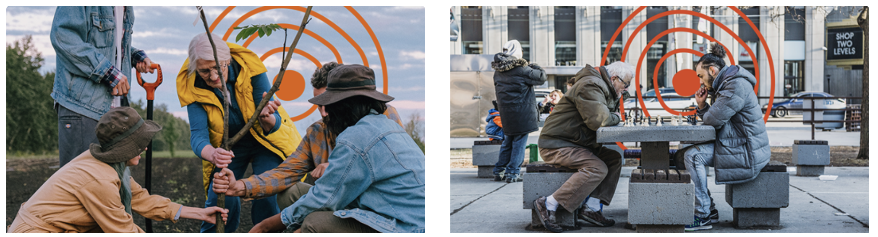
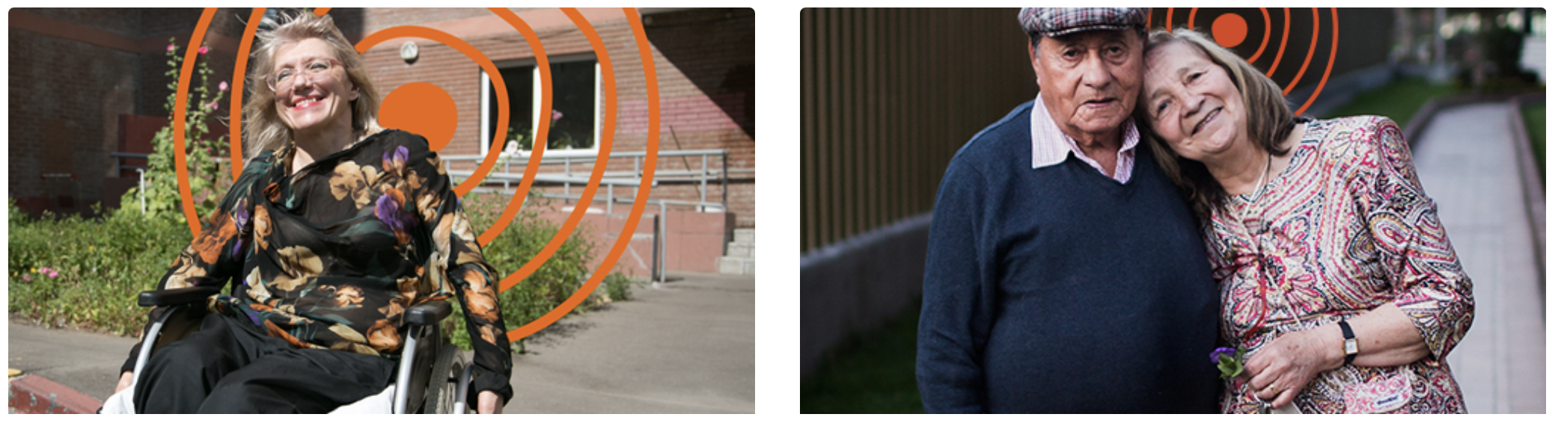
4 Main Areas
Age-friendly environment
Against ageism
Integrated care
Long term care
Notes:
- mengubah cara kita berpikir, merasa dan bertindak terhadap usia dan penuaan;
• memastikan bahwa masyarakat mendorong kemampuan orang tua;
• memberikan perawatan terpadu yang berpusat pada orang dan layanan kesehatan primer yang responsif terhadap orang lanjut usia;
• menyediakan akses ke perawatan jangka panjang untuk orang tua yang membutuhkannya.

Slide 47
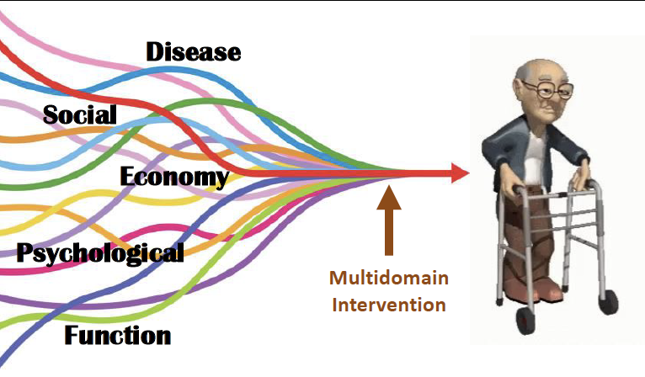

Slide 48
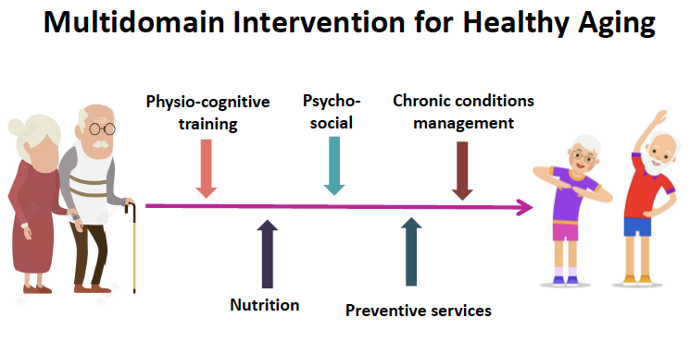

Slide 49
Towards healthy aging
Maintan body weight
Eat healthy food
Exercise regularly
Breathing clean air
Refrain from tobacco use
Take an active role in the community
Vaccination
Aronson, L., 2020. Healthy Aging Across the Stages of Old Age. Clin Geriatr Med, Volume 36, pp. 549-558.

Slide 50
THANK YOU

